Slide 1
Exercise session #4
Science of
Climate Change
Oct. 3, 2024

Slide 2
Questions from last time
Recap from lecture
Introduce posters
Quick exercises
Questions on assignment?

Slide 3
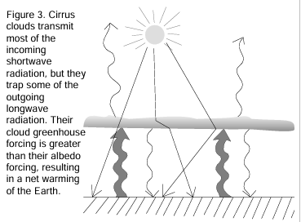
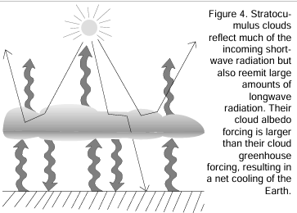
Solution: How do clouds affect our climate?
High cloud
High clouds
  High, thin clouds, like cirrus clouds are transparent to shortwave (SW) radiation and absorb emitted longwave (LW) radiation from the Earth.
  Net effect: Warming
Low clouds
  Low, thick clouds reflect SW
  They absorb and emit LW radiation
  Net effect: Cooling
Overall effect: Cooling
Low cloud

Slide 4
Recap from lecture

Slide 5
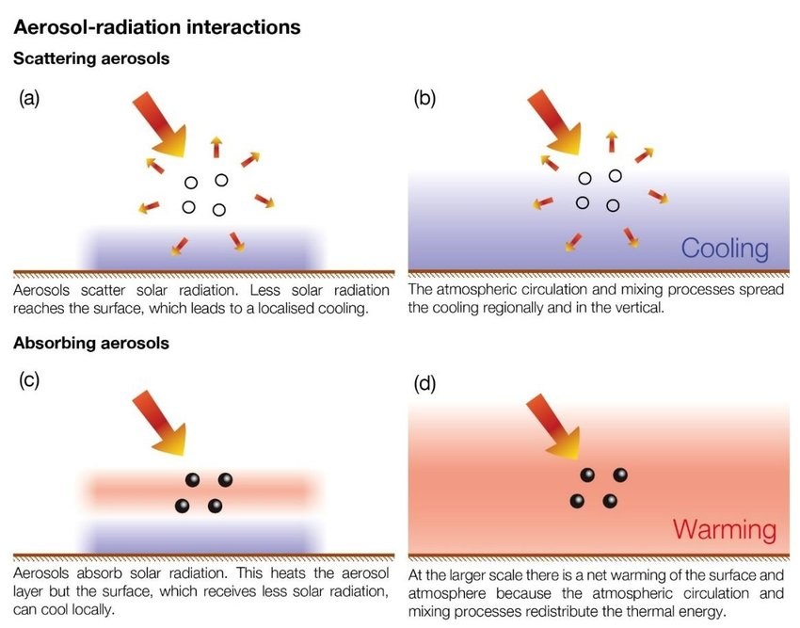
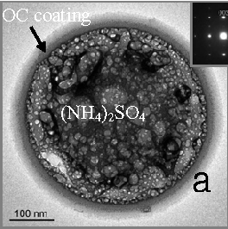
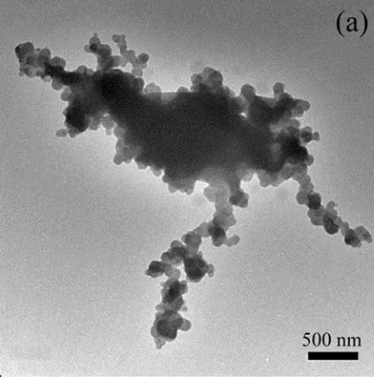
Aerosol-radiation interaction
Aerosols reflect solar radiation, thereby shielding (masking) the Earth’s surface from radiation
Ammonium, sulfate, nitrate, some organics
Aerosols absorb solar radiation, thereby warming the air
Soot and some types of mineral dust
http://www.climatechange2013.org/report/reports-graphic/ch7-graphics/
Notes:
http://www.climatechange2013.org/report/reports-graphic/ch7-graphics/

Slide 6
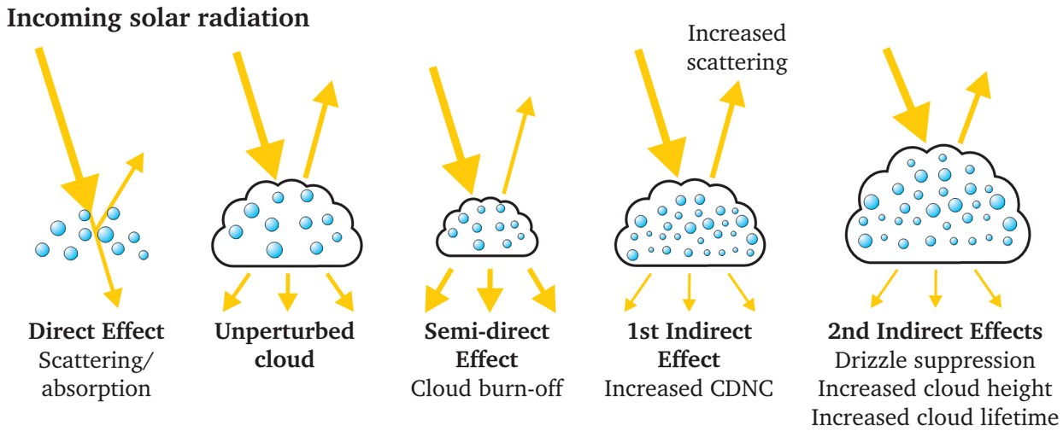
Aerosol-cloud interactions
Pristine clouds
Polluted atmosphere and clouds
Air becomes warmer and clouds do not form or evaporate
CDNC – cloud droplet number concentration
Higher albedo
No big drops
Notes:
https://allaboutaerosol.files.wordpress.com/2015/10/aerosoleffects.jpg

Slide 7
ERF by component
GHG make up roughly 3.7 W m⁻² radiative forcing
Compare: to TOA outgoing LW of -240 W m⁻²
Negative leads to temperature decrease
Positive forcing leads to temperature increase
Effects of most important GHG are well understood, the largest uncertainties are with aerosols and clouds.
IPCC AR6, Fig. TS.15

Slide 8
Posters (25% of final grade)
Deadlines & grading
How to write the poster research proposal
How to design a conference poster
How to present a poster

Slide 9
Deadlines and grading
10 Oct
Final topic choice
1 Nov
Submit proposal
21
Nov
Poster draft submission
Dec 5
Final poster submission
Dec 12
Conference
now
Pick a topic
Send poster for printing, latest 9th December (10am)
Reminder:
Assignment deadline 28 Nov
We provide feedback
We provide feedback
5 % for submission of the proposal
15 % for content and visual of the final poster
5 % for conference day presentation

Slide 10
What is a poster research proposal ?
Formal document setting out what the research plan is and how this will be achieved.
For this course: short summary of motivations and background of your chosen topic i.e. what can we expect to see in your poster
Aim for : informative, concise/to the point, have a clear direction
What is the topic, Why is it important, what are the key points
Avoid : being vague, over-explaining, lacking references

Slide 11
How to write a good poster proposal?
The proposal must look as follows:
Provide a tentative title
Write your key messages, no more than 400 words.
Provide 3 key references
The proposal should summarize the content of the poster, you will have to collect information from the literature and extract the key points that you want to have in your poster.

Slide 12
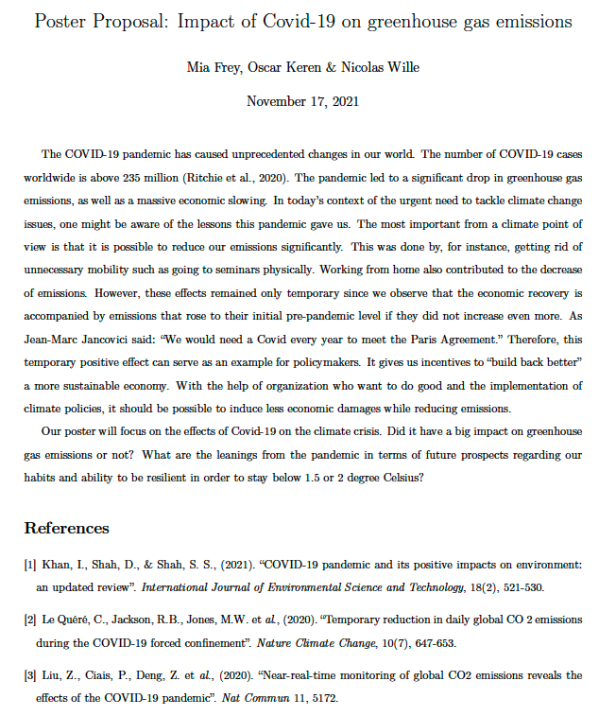
How to write a good proposal?
Random example from last year:
Feedback we provided:
The proposal is quite vague (what are the key messages, how/where are you going to include the references).
Please consider the following additional references:
1. https://www.pnas.org/content/118/46/e2109481118 that demonstrates feedbacks between air quality and the carbon cycle.
2. https://gml.noaa.gov/ccgg/covid2.html on the impact of Covid-19 on CO2 atmospheric concentrations.

Slide 13
How to write a good proposal?
Random example from previous years:
Feedback we provided:
The proposal is quite vague (what are the key messages, how/where are you going to include the references).
Please consider the following additional references:
1. https://www.pnas.org/content/118/46/e2109481118 that demonstrates feedbacks between air quality and the carbon cycle.
2. https://gml.noaa.gov/ccgg/covid2.html on the impact of Covid-19 on CO2 atmospheric concentrations.
Take home:
Make sure message is clear – aim for several key points and communicate them clearly
Link references to text (show understanding of how to search literature and reference correctly)
Key points of poster listed concisely
Correct referencing
Reminder:
Proposal is not graded HOWEVER you must submit one in order to get the 5 % for this section of the course

Slide 14
Why posters ?
  Aim of a scientific poster:
  Inform on summarized version of your science – specifically relating to but not directly from the lecture series
  Broaden knowledge and apply lectures to more real-life science questions
  Skills:
  Ability to summarise and condense research into manageable bite size chunks
  Ability to disseminate to a non-scientific audience – how can you make your science accessible and easy to understand to a wider audience

Slide 15
How to design a good poster?
A0 and portrait. Submit a as a pdf file!
Has to be readable (font size > 20 pt) and have a clear structure
Good balance of text and figures
  Make sure figures are also legible and all components within are easily readable
Must include:
  Title
  Name of the group members
  Main topic
  Take-home message
  References
Useful references:
  https://guides.nyu.edu/posters
  https://www.nature.com/scitable/topicpage/poster-presentations-13907939/

Slide 16
How to design a good poster?
What does the audience want from reading your poster?:
  Familiarize your audience quickly with the topic and convey the key messages in an easy to understand way
  The poster is self-explanatory and can be understood also in the absence of the presenter
  A poster is a short version that emphasizes only the important components of the knowledge you hold
  The idea is not to write down everything you know
  You can add more information verbally when you present the poster – in fact healthy discussions are encouraged ☺
Aim for :
Less text
Use images/graphs to highlight the key messages
Allow your audience to grasp the content in about 2-3 minutes
Clear, well formatted and structure – try to draw the eye
Avoid:
Overfilling poster with information
Small figures
Tiny font
Unclear structure (unknown what order audience should read in)

Slide 17

How to design a good poster?
Good design example (note: yours must be portrait mode)
Text is only bullet points.
Headers are short and clear.
The images are easy to understand and take as much if not more room than text.
One can grasp the key messages in 1-2 minutes.

Slide 18

How to design a good poster?
Poor design example
Too much and very small text.
Unclear where to focus.
Unclear what the key messages are.
It will take a long time to grasp the content.

Slide 19
How to successfully present your poster?
Prepare two types of presentations:
  “elevator pitch” (20-30 seconds): main topic, take-home message
  ~3 minutes presentation
Be ready for questions
Sign-up sheet:
https://docs.google.com/spreadsheets/d/1-Ycty0QhmH7vtfcqgtsub4hHtBCt5K9pOlQ1LTfPc_8/edit?usp=sharing
Notes:
Give an example of an elevator pitch for my own research

Slide 20
Random selection of examples from the 2 previous years:

Slide 21
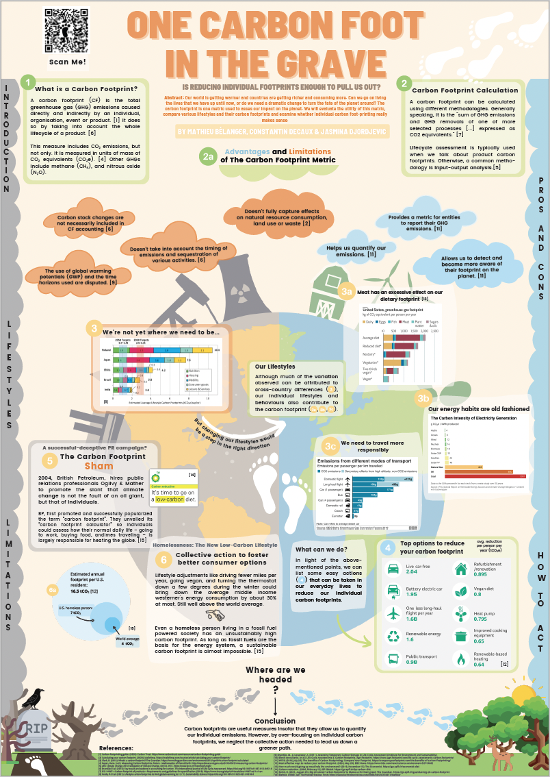
Random selection of examples from the 2 previous years:

Slide 22
Random selection of examples from the 2 previous years:

Slide 23
Random selection of examples from the 2 previous years:

Slide 24


Random selection of examples from the 2 previous years:

Slide 25
Exercises

Slide 26
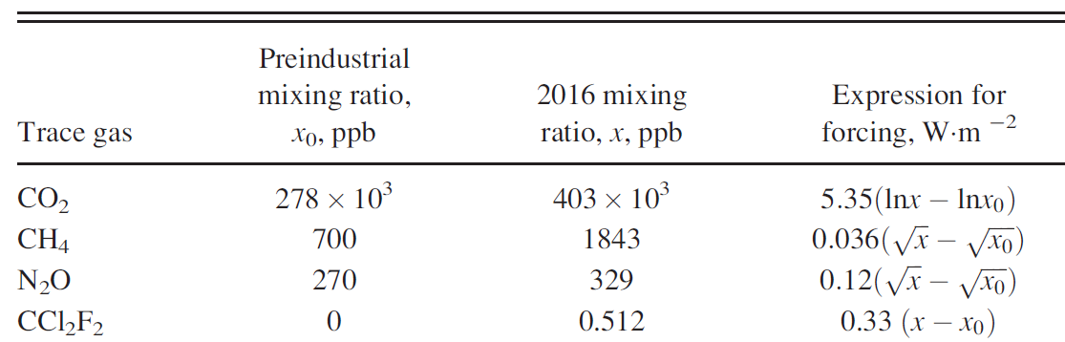
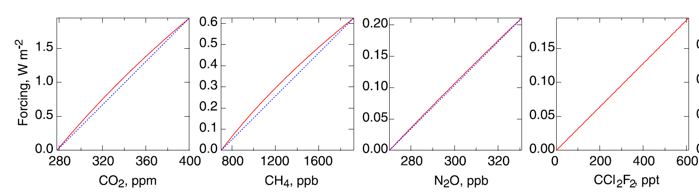
Exercise 1: Radiative forcing of GHG
sublinear
Used to calculate red lines in graphs.
sublinear
sublinear
linear
Slopes of linear fits (blue dotted): units in W m⁻² ppb⁻¹
0.0000159
0.00051
0.0035
0.33
Schwartz, 2018, https://doi.org/10.1119/1.5045577

Slide 27
Exercise 1: Solution
Calculate the relative forcing in 2016, for all the four GHG on the previous slide. Which had the smallest forcing?
Solution
  CO₂: 1.99 Wm⁻²
  CH₄: 0.59 Wm⁻²
  H₄O: 0.20 Wm⁻²
  CCl₂F₂: 0.17 Wm⁻²

Slide 28

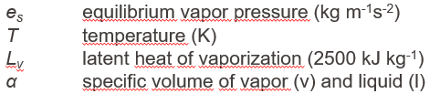

Exercise 2
How much more water vapour will the atmosphere be able to hold if it warms by 1ºC?
The average temperature of the atmosphere at Earth's surface is 14 °C
Solution:
$\frac{∆e_{s}}{e_{s}}=\frac{2500e3}{287 ×461.5}×\frac{1}{287}=$ 6.68%

